Slide 1
Technology Update J. Carlton Collins

Slide 2
1. The Task Force has Requested Me… Technology Update Cloud Computing 2. Overlap… 3. I will Save the Cloud Stuff… 4. Expect A Little Redundancy…
Notes:
Task Force - The SEAS task Force has asked me to deliver two presentations, back to back, titled Technology Update and Cloud Computing, and I am happy to do so.
Overlap - However, this is a rather difficult task because there is so much overlap. Most of the interesting things happening in technology are related to Cloud computing.
I will Save the Cloud Stuff - Therefore, I will try to talk about technology without mentioning cloud computing, and save that material for my cloud computing presentation.
Expect Redundancy - However, there will be a little overlap for those attending both sessions.

Slide 3
1. Works like a bar code 2. Make your own Tag(s) for free 3. Links to your web site or to a web page designed for cell phones 4. See GSCPA tag in action
Microsoft Tags

Slide 4
1. No Moving Parts, Much Faster, Less Susceptible to Damage 2. No spin up time – so almost immediate results 3. Uses far less energy 4. Fragmenting not an issue 5. 10 to 20 more expensive ($1-$2 /GB vs $10-$20/GB) 6. HHD 56,00, 72,00, 10,000, 15,000 RPM 7. Performance degrades over time. 8. Limited life span. 9 Hybrid drives
Solid State Drives

Slide 5
1. Wireless Routers A Range of half a house B Range of half a house G Range of Whole house Super G Range of three houses N Range of 17 houses WiMax Range of 50 mile diameter
3G vs 4G

Slide 6
1. WiMax is also known as 4G 2. It is available as a hotspot, but most 4G technology is found in the cellular phone industry. 3. Speed up to 1,000 MBs But spigot controlled 4. 3G is 1.5 MBs, (or about 5 times faster than a phone line)
3G vs 4G
Page 9

Slide 7
1. MIMO 2. Frequency Division (multiple users share a channel) 3. Dynamic Channel Allocation (Load balancing between stations) 4. Channel-Dependent Scheduling (More efficient MIMO) 5. Better Frequency
Page 9
4G is Actually Several Technologies

Slide 8
1. 2007 – Apple iPhone 2. 2010 – Apple iPad 3. Both devices launched those industries 4. Apple’s Market Cap
Smartphones and Tablets

Slide 9
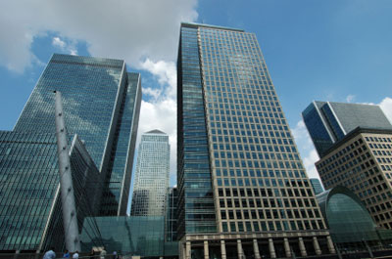
Exxon 359 Apple $351 Billion Microsoft 210 Wal-Mart 178 IBM 203 Google 172 GE 171

Slide 10
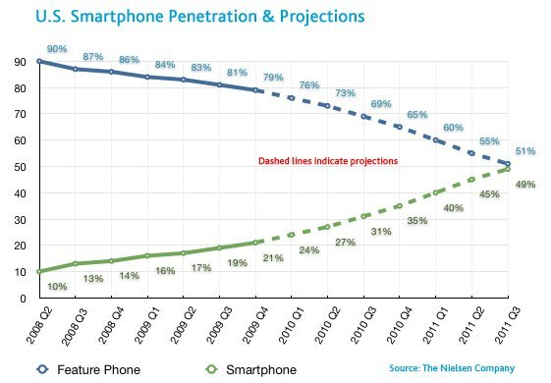
Smartphones Sales

Slide 11
How many I have smartphones? iPhone? Google Android Phone? Blackberry?
Smartphone Survey

Slide 12
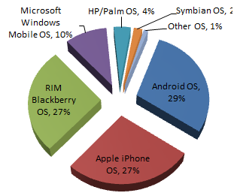
Smartphone Market Share

Slide 13
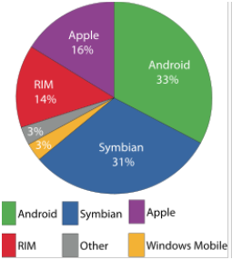
Smartphones Operating Systems

Slide 14
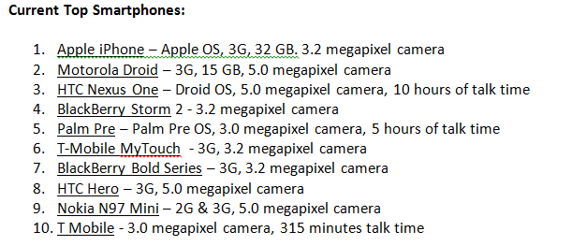
Top Smartphones

Slide 15
Top New Smartphones

Slide 16
Detailed Comparison of Smartphones by features: http://en.wikipedia.org/wiki/Comparison_of_smartphones
Smartphones

Slide 17
1. Browser based Internet Access 2. Strong E-Mail 3. Camera 4. Speaker Phone 5. 100,000 Apps
A Few Smartphone Features

Slide 18
1. Text Message (Using Voice) 2. Navigation (Using Voice) 3. Turn-by-Turn Directions 4. Traffic 5. E-Mail 6. Docs, Calendar, More 7. Camera, Pictures, to FB 8. Open Table 9. Market
Smartphone Apps Demonstration
10. Flashlight
11. Sky
12. Decision Making Tools 13. Piano
14. Microsoft Tag
15. Compass
16. Radar Now
17. Connect Wi-Fi
18. Maps

Slide 19
1. Recharger – Office 2. Recharger – Home 3. Recharger – Car 4. Recharger – Luggage 5. Ear Piece (Bluetooth) 6. Headphones for Office use 7. Motorcycle Headphones 8. Speakers 9. Protective case
Smartphone Accessories

Slide 20
1. Start with best provider in Your Locality. AT&T, Sprint, Verizon, T-Mobile 2. Chose a 4G option Usually $0 to $200 with contract.. 3. www.Verizon.com
Choosing A Smartphone

Slide 21
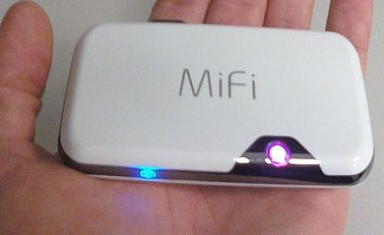
1. Converts Smart phone into a 5 user Wireless Router 2. Some Smartphones can do this themselves, but because battery life is big issue, MiFi is essential
MiFi

Slide 22
1. 2001 - Microsoft introduced first tablet Laptop with touchscreen Still had to boot up 2. Jan 2010 – Apple iPad Basically a big iPhone, without the phone Easier to read No monthly subscriptions cost *
Tablets

Slide 23
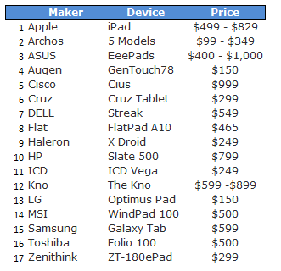
Tablets
Page 6

Slide 24
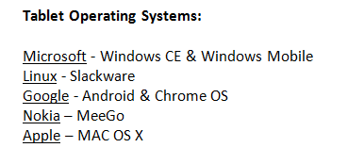
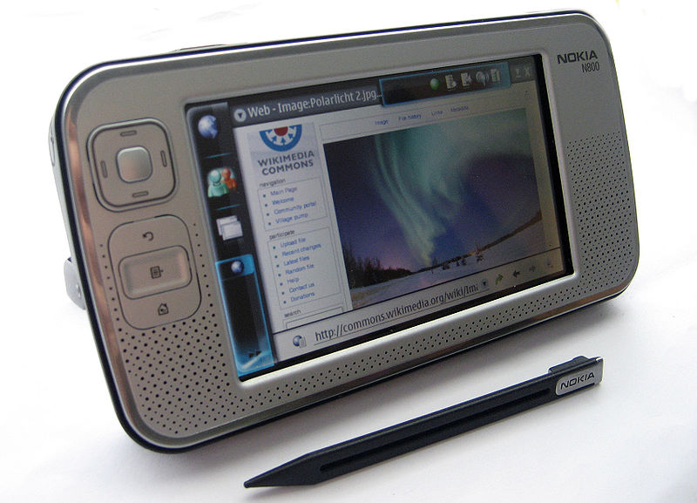
Tablet Operating Systems

Slide 25
1. Wi-Fi vs 3G vs 4G 2. Two cameras 3. Apps
A Few Tablet Features

Slide 26
1. Safari Browser 2. Keyboard 3. Camera 4. Pictures (pinch, tap) 5. Photobooth 6. Video 7. Notebook 8. Maps (Peek behind)
Tablet Demonstration
9. YouTube
10. GoToMyPC
11. iBooks
12. Skype
13. Angry Birds
14. Fruit Ninja
15. Apps

Slide 27
1. Well over 100,000 apps 2. Free or Nearly Free
Apps for
Smartphones and Tablets

Slide 28
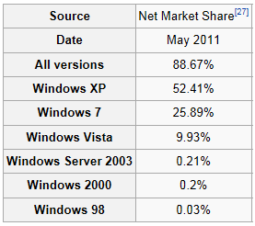
Page 12
Windows Operating Systems
Apple 6+%
Windows 7 is More secure
Ram supported: 4GBs, 128GBs, 192GBs for XP, Vista and 7 (64 bit).
Processors Supported: 1, 64, 256 for XP, Vista and 7, respectively.

Slide 29
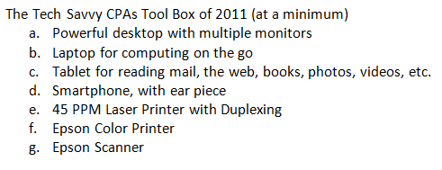
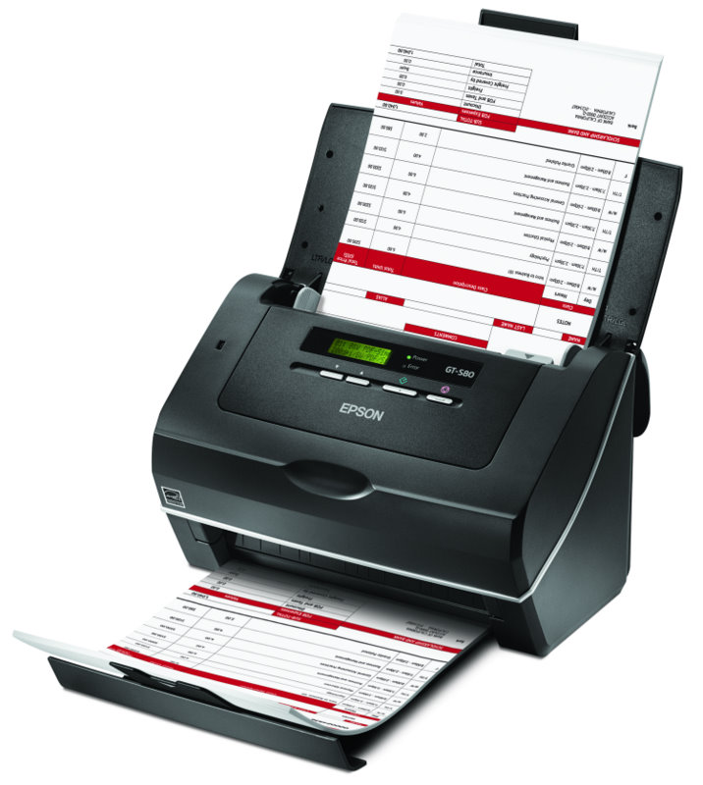

Slide 30
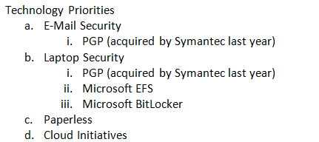

Slide 31
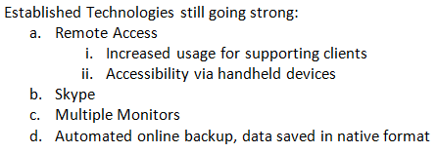
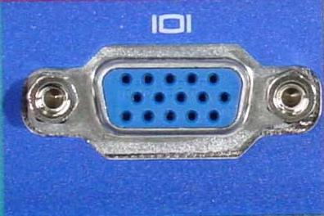
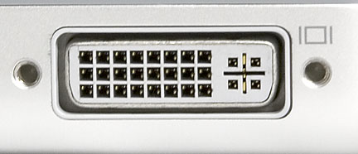
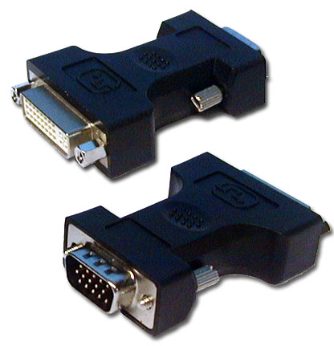
Field Monitor Pro

Slide 32
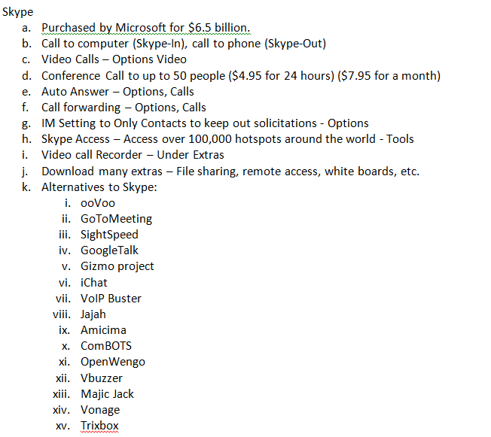

Slide 33
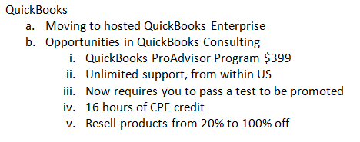

Slide 34
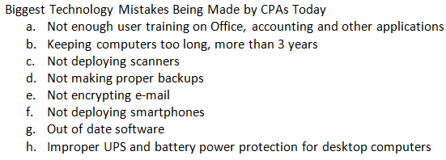

Slide 35
New Accounting Software Solutions Gain Traction: (Cloud Solutions)
ZOHO Books - Online accounting solution, $24.95 per month, multi-currency, share and delegate workflow, dashboards, recurring invoices, thank you notes. http://www.zoho.com/books/
Outright – Cloud based solution that eliminates data input by grabbing revenue and expense transactions from your bank statements, credit card statements, scanned in receipts and your Paypal account. $24.95 per month. http://outright.com/
Xero – Google’s Xero is online accounting priced at $19 per month, includes inventory, payroll and invoicing solutions along with fixed asset depreciation, contact management, multi-currency, dashboard reporting workflow and electronic banking. http://www.xero.com/
FreshBooks – Bevy of modules including time tracking, estimating and staff management, cloud based solution priced starting at free to $40 per month. http://www.freshbooks.com/

Slide 36
52% of CPA Firms are now Paperless
If we took all of the information and store it in books, we could cover the entire area of the United States or China in 13 layers of books. – Dr. Milton Hilbert.
Key paperless solutions used by CPAs include:
CCH, a Wolters Kluwer business
Concur Technologies
Doc.It
Fujitsu Computer Products of America
ShareFile
SmartVault (includes plug-in for QuickBooks)

Slide 37
YouTube
Wonderful Source
2. Every 60 Days…More Content than ABC, NBC, CBS
3. Examples – RFID, ATM Fraud

Slide 38
YouTube:
More content published to YouTube in a 60 day period than the three major U.S. television networks created in the past 60 years. 490 million unique users worldwide per month, who rack up an estimated 92 billion page views each month.
YouTube is a phenomenal learning center. Carlton’s Prediction – YouTube University will be the world’s largest learning center within 5 to 10 years.
www.tubechop.com – Crop a portion from any YouTube video
www.mixpod.com – Combine cropped portions of YouTube clips
www.vixey.com – Convert YouTube clips to self-running MP4s on your computer
Uploading to YouTube is Easy (quick demonstration)
Embedding Code (Bandwidth and Codecs come from YouTube web site)

Slide 39
Wikipedia
Wonderful Source
2. Create your own Wiki

Slide 40
Web Content Filtering:
Set Google or Bing search preferences to “Strict”
Install SonicWall router/firewall with filtering at the router
NSA 3500 – 1GBit Speed, Wireless, Content Filtering, $851 and up

Slide 41
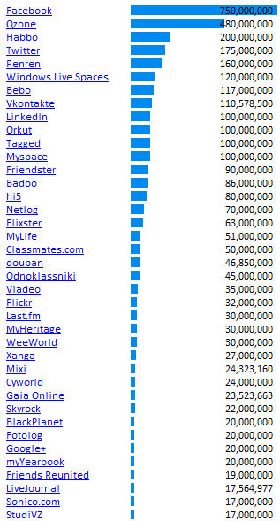
Social Network Sites:
Social Media Related Patents
More than 200 Social media Web Sites (excluding dating web sites) Here are top web sites by number of users:
Why would anybody pay $45 a year for Classmates.com?

Slide 42
Web 1.0 versus Web 2.0 versus Web 3.0
Web 1.0 - Passive, static web pages that merely allow one to retrieve information.
Web 2.0 – Participation, collaborate, Information sharing, cloud computing
Web 3.0 – Introduces logic, for example, search for an airline ticket and it also finds hotels, rental cars, activities for you.

Slide 43
Over the Top Technology
RFID Based Doggy Doors with Twitter Notification
Tooth Receiver – Listen to radios, cell phones via transmitter in your tooth
Laser keyboard
Smartphone Projector
Thin Flexible Monitors
Vein Viewer
Fish Tank Toilet
Dolphin Boat - Video
Growing Body Parts
Tandem Bike
Evian Commercial – Babies Skating

Slide 45
Microsoft Surface
Microsoft Surface
Paraody
Newer Movie – Samsung SUR40
Kiosks, Visitor Centers,
Future?

Slide 46
Robotics
Honda’s Asimo – Still working the hugs out
Reaper Drone
Small dragonfly – Insect Drones

Slide 47
E-Mail Trends
E-Mail use has declined 40%
Texting and social networks have replaced e-mail
90% of my e-mail is junk
Less than 1% of my facebook or texts are junk, I am sure that will change

Slide 48
The Future of Reading the News
Average age of newspaper reader is 55
Newspapers subscribership is way down
NYT Shares NYT Subscribers
Newsweek was sold for $1 dollar
Each day AP produces thousands of news stories, who will filter those stories for you in the future?
Matt Drudge? One trillion hits a year…and growing.
Matt’s not smart
Matt’s can’t write well…I’ve read his book.
Matt only links
Digg
Digg relies on public filtering
I like matt’s filtering much better
Huge Political Implications

Slide 49
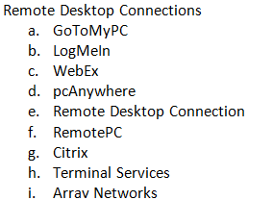

Slide 50
Speech to Text
In Office 2003
Not in Office 2007
Not in Windows XP
In Windows Vista
Boom microphone

Slide 51
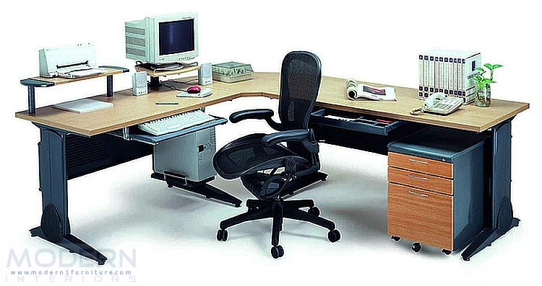
Well Organized Computer System

Slide 52
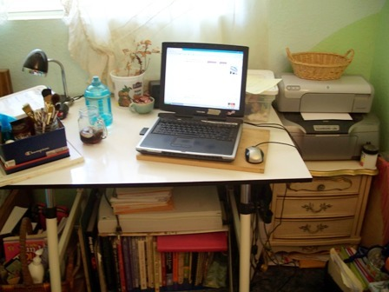
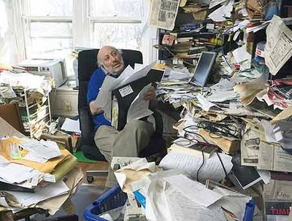
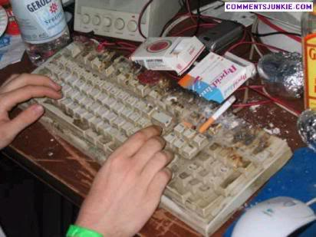
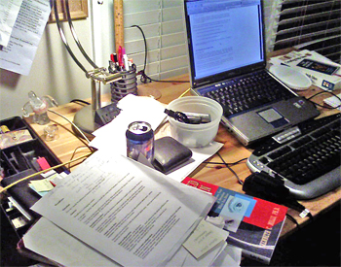

Slide 53
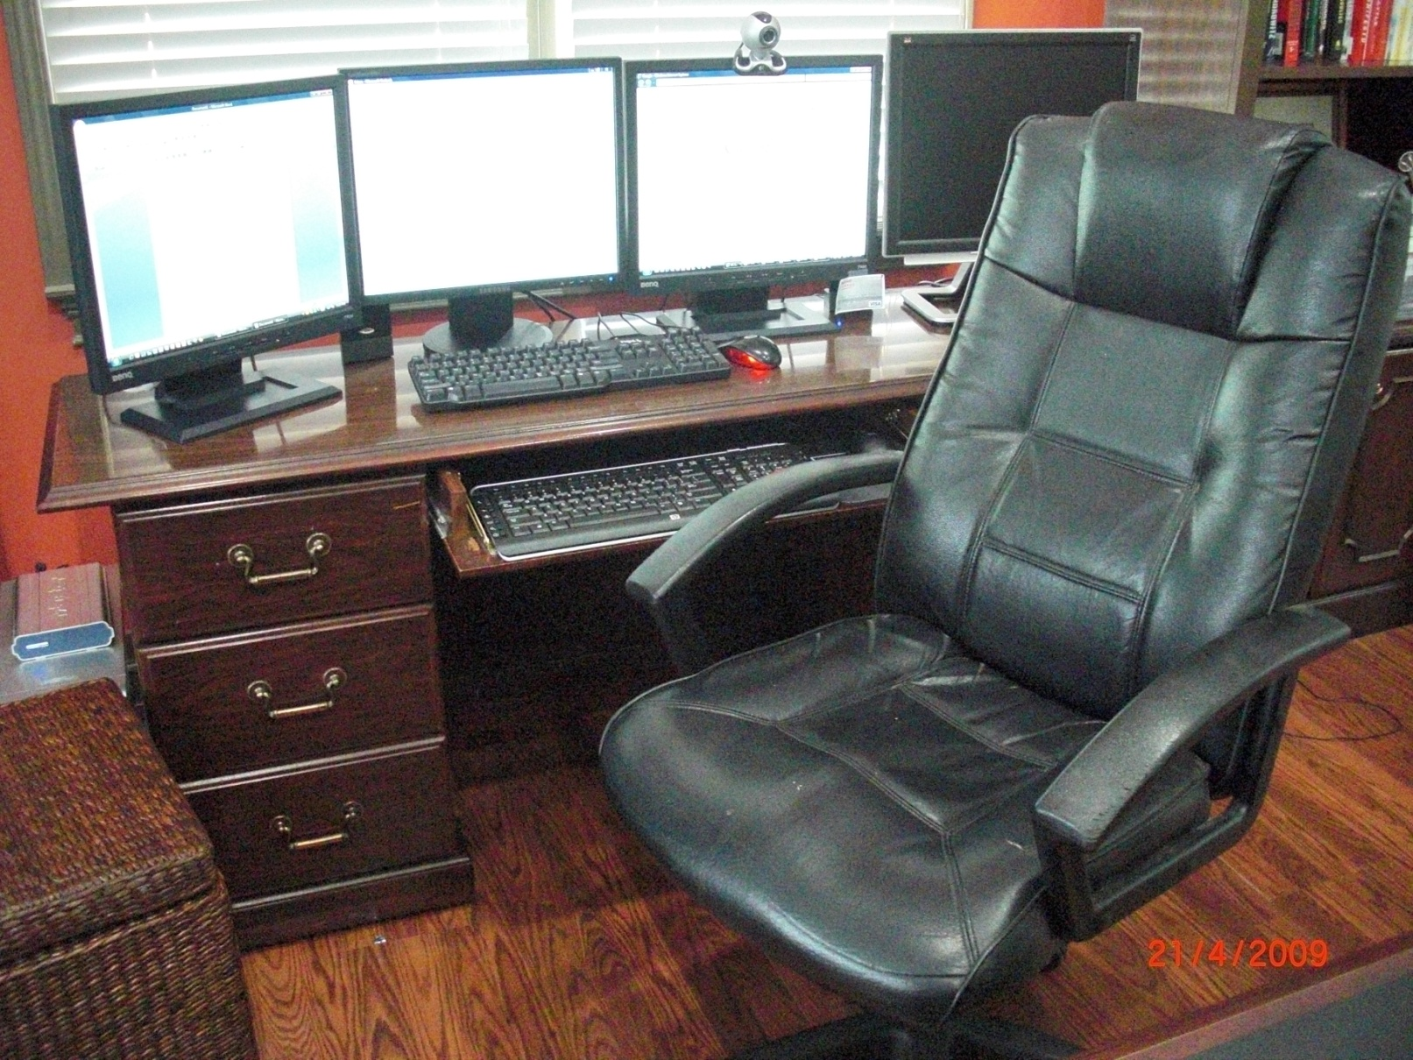
My Computer System

Slide 54
Laptops are not Ergonomically Sound
Ouch
Ouch

Slide 55
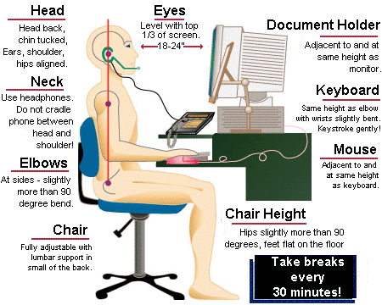

Slide 56
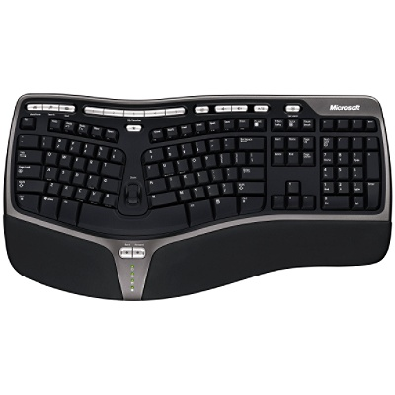

Slide 57
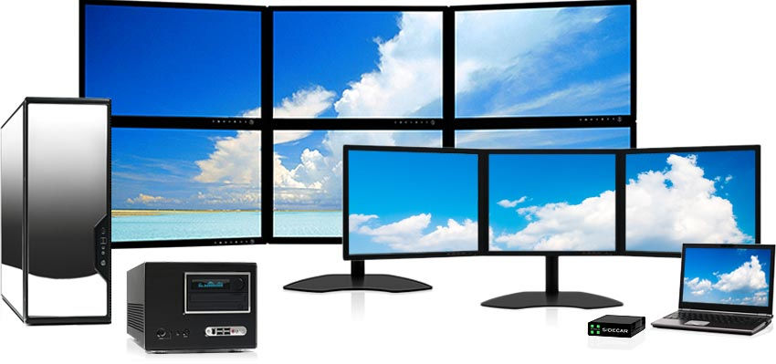
Multiple Monitors

Slide 58
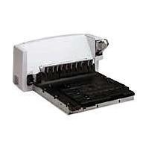
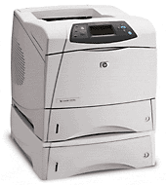
Duplexing Printer

Slide 59
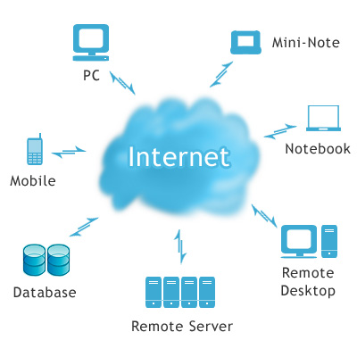
Cloud Computing
What is Cloud Computing?...Why is it Better?...Why do we need it?
Cloud Computing – The concept of cloud computing is not new; it dates back to the nineteen-seventies when timesharing systems allowed dumb computer terminals to connect to, and rent time from, remote mainframe systems. Since that time, this concept has been referred to by many names such as “Timesharing systems”, “Remote Job Entry”, “Network Computing”, “Web-Based Solutions”, “Software as a Service (SAAS)”, and most recently – “Cloud Computing”.

Slide 60
While there are many differing and complex definitions for cloud computing, in simple terms “cloud computing” means that your applications and data reside on a remote computer sever rather than your own desktop computer or mobile device. Thereafter, users connect to their applications and data via the internet, which is ubiquitously referred to as “the cloud”. (The term “cloud” is derived from the cloud shape that many designers use to represent the internet when diagraming networks).

Slide 61
Windows Live/Office 365
Cloud based Solution
Office 365 - $10 Per Month

Slide 62
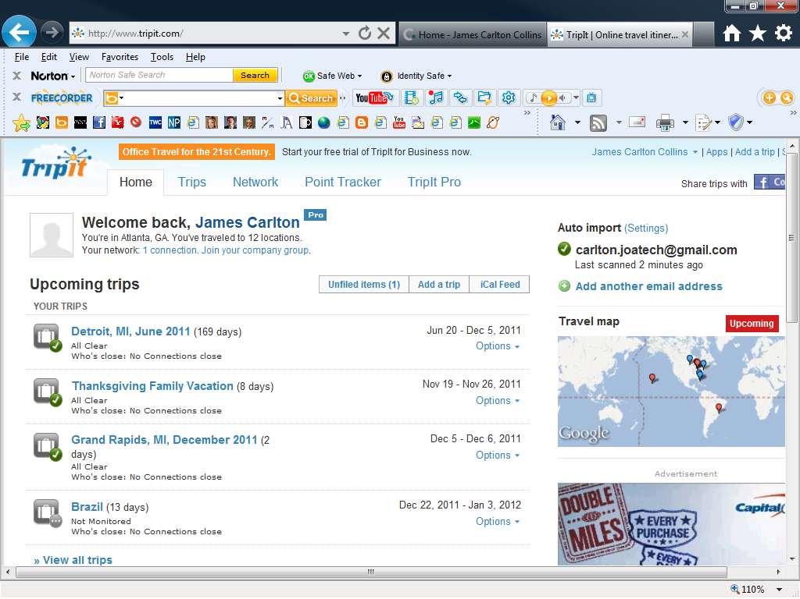
TripIt Demonstration

Slide 63
TripIt Demonstration
1. Make Avis Reservation
2. Receive Avis Reservation
3. Forward Avis Reservation (Dec 5-6)
4. View Results on Smartphone/Tablet
5. Hotel, click address, directions, map, navigate

Slide 64
Concur Breeze

Slide 65
Concur Breeze Demonstration
Computer
- Import Credit Card Data
- Add credit card data to a new exp. report
- Shows up on smartphone
2. Smartphone
- Add Quick Expense
- Take picture of receipt
- Shows up on Computer

Slide 66
The Future of Reading the News
Average age of newspaper reader is 55
Newspapers subscribership is way down
NYT Shares NYT Subscribers
Newsweek was sold for $1 dollar
Each day AP produces thousands of news stories, who will filter those stories for you in the future?
Matt Drudge? One trillion hits a year…and growing.
Matt’s not smart
Matt’s can’t write well…I’ve read his book.
Matt only links
Digg
Digg relies on public filtering
I like matt’s filtering much better
Huge Political Implications

Slide 68
Perfect Examples of a Cloud Solutions 1. Facebook 2. Surveys (Like Survey Monkey) 3. Wikipedia 4. Xero, FreshBooks, Zoho 5. Google Alerts 6. YouTube CPA Specific Solutions 1. CCH Tax Prep/Storage/Research 2. Concur 3. TripIt

Slide 69
Google Maps
Street view
Driving Directions
Re-route
Add multiple stops
Traffic
Map Views

Slide 70
Web Site

Slide 71
Securing a Domain Name
GoDaddy
Domain Name
AccountingSoftware2010
Hosting
Show Checkout Screen

Slide 72
Building a Web Page
FrontPage
Login
New Page, Titles, Text, Accounting Software
Content
Feedback Form
YouTube Clip
Embed YouTube Clip in Web Page
Demonstrate
Recording Camera Videos
Search, find picture, save
Crop picture
Insert Picture
Polygonal hotspots

Slide 73
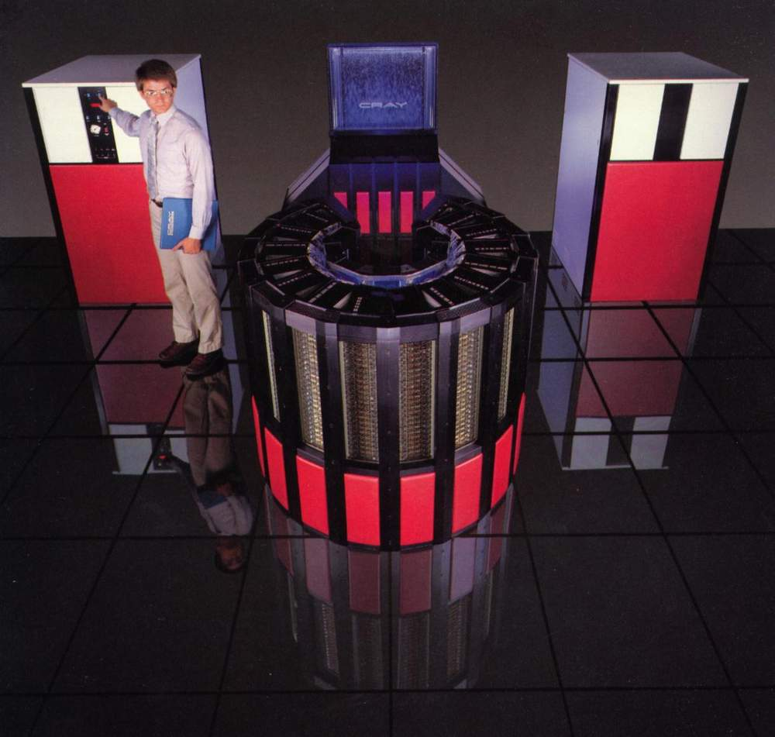
Cray Super Computer
Same components
More Core Processor Chips
Chilling Towers

Slide 74
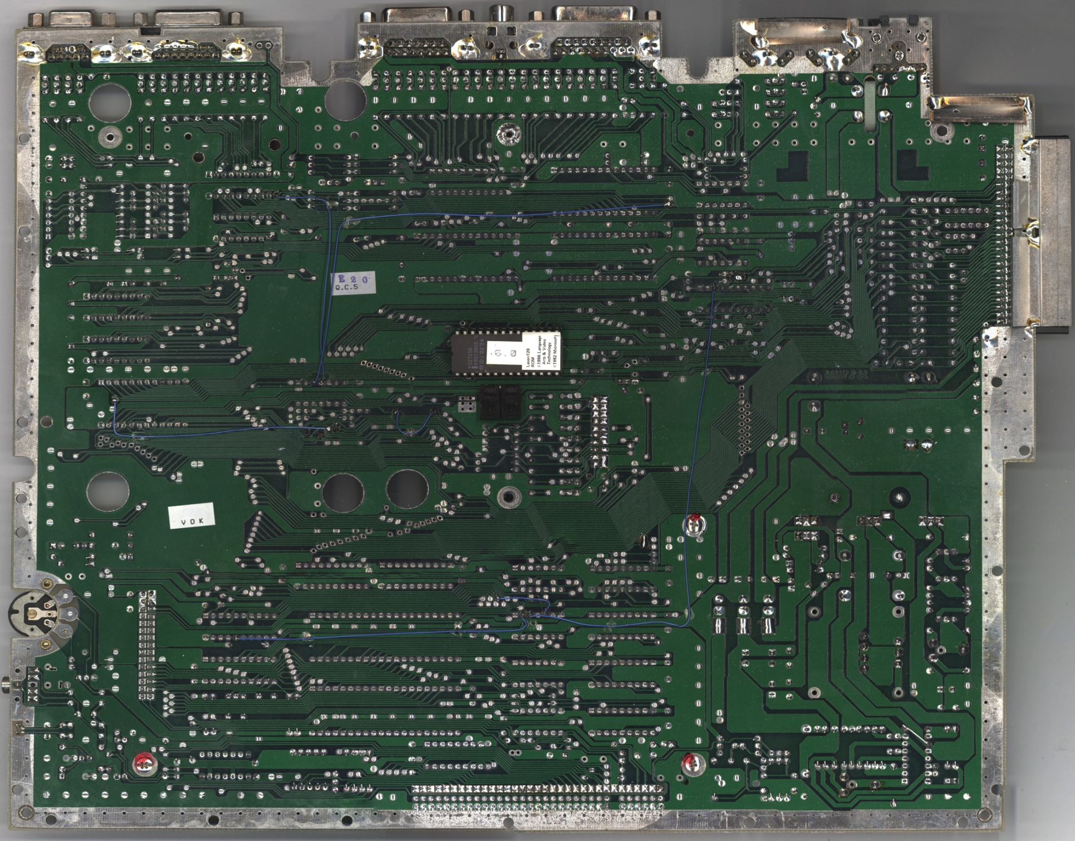
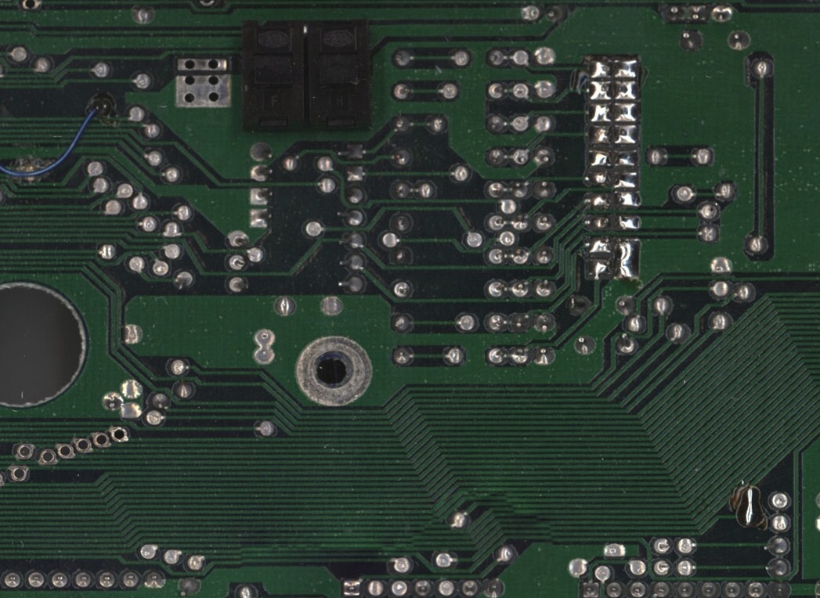
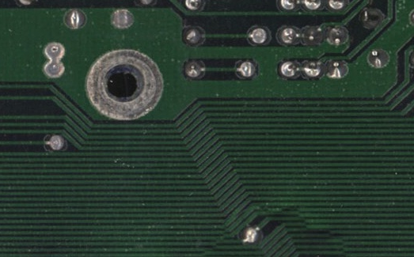
64 Bit Motherboard has 64 Lanes of Traffic embedded

Slide 75
64 Bit Points
32 bit = Personal computer
64 bit = Mini computer (IBM AS/400)
128 Bit = Mainframe computer
All computers 64 bit since 1994
Most still use 32 bit operating system
Windows XP and Vista come in 32 or 64 bits
64 Bit is faster
Applications must be tweaked to run on 64 bit

